Slide 1
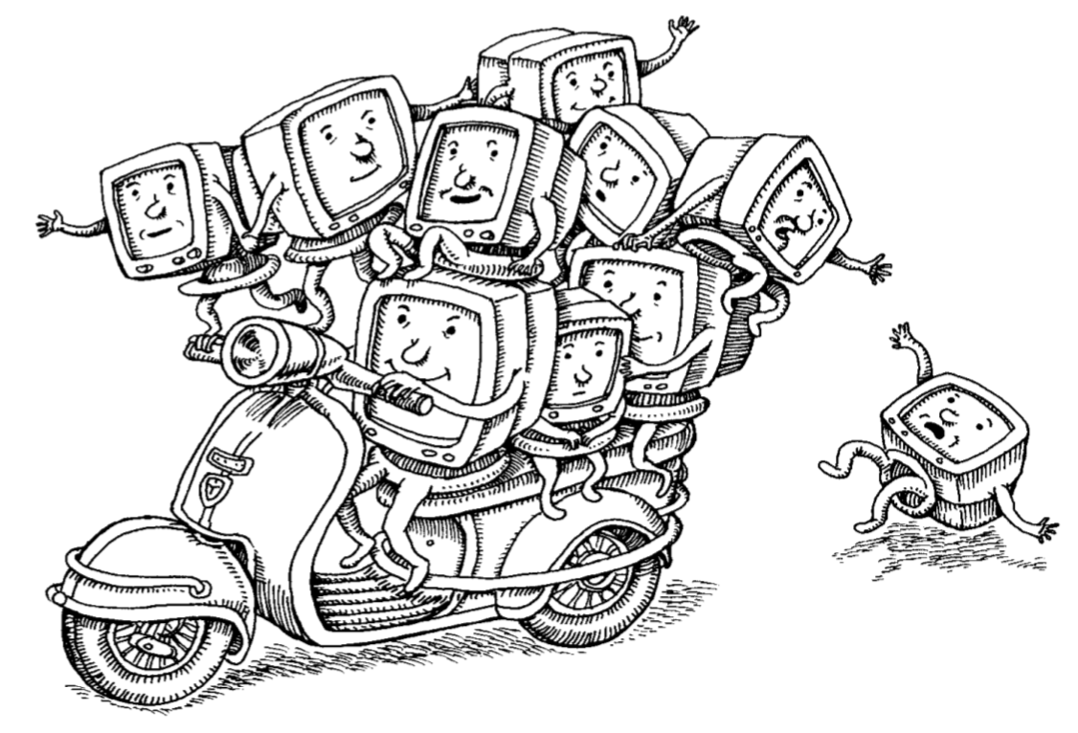
Virtualization

Slide 2
Virtualization
Virtualization is the process by which a hosts hardware is made virtual accessible through the means of a hypervisor, which mediates the interactions between virtual systems and the underlying hardware
Hypervisors can make hardware accessible in a few different ways
Full Virtualization: emulates all the underlying hardware, translating interactions between the guest OS and the virtual hardware to the underlying physical hardware which incurs a quite large overhead in performance
Paravirtualization: modified guest OS detects that its being virtualized and works directly with the hypervisor to access hardware, which reduces overhead but requires OS modification in order be able to directly interface
Hardware-assisted Virtualization: extends the CPU instruction set to allow better CPU and memory virtualization by hypervisors, other components must be otherwise virtualized
Paravirtualized Drivers: virtualize only the necessary guest OS drivers rather than virtualizing the hardware itself, still doesn’t cover non-CPU/driver systems like BIOS
Notes:
These are not strict definitions used on hypervisors, but instead types of virtualization that hypervisors can implement. Most modern hypervisors use a combination of these various virtualization techniques to provide full virtualization with low overhead and good performance

Slide 3
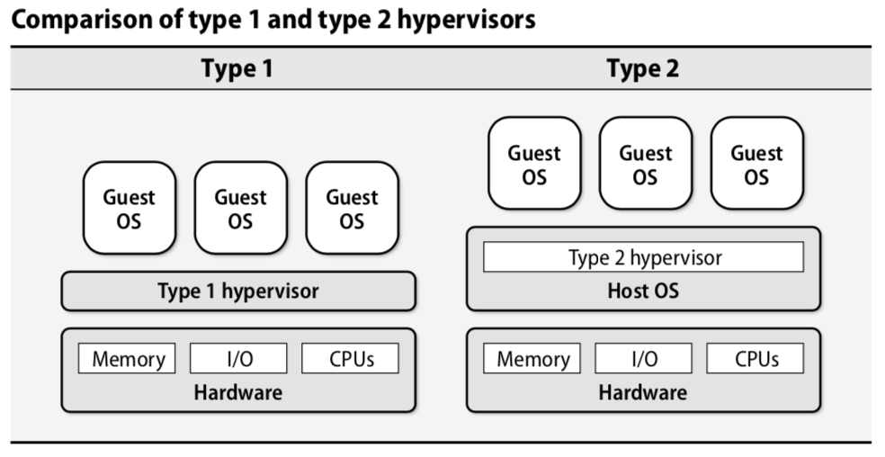
Hypervisors
Hypervisors fall generally into two main types, type 1 which runs directly on the hardware and type 2 which runs on a host OS

Slide 4
Benefits of Virtual Machines
Segregated Multi-tenancy: because we can create multiple guest OS per hypervisor and each guest OS is viewed by the guest OS (more or less) as its own host we can run multiple systems and applications with very different configurations, OS, and software stack without them interacting (mostly)
Easier Deployment & Provisioning: since virtual hardware looks the same when using the same hypervisor (no matter the underlying hardware configuration) we can provision a new OS and software stack onto any host. We can also save the current state of what is running on the hypervisor.
Live Migration: since the CPU, memory, and disk are virtualized all memory can be saved and loaded into a new virtual machine without any* downtime

Slide 5
Virtualization Systems & Tools
Virtualization Systems
Xen (Linux)
Kvm (Linux)
VMWare ESXi (Linux)
Bhyve (FreeBSD)
VirtualBox (Cross-Platform, For Individual Use)
Virtualization Tools:
Packer & Vagrant: HashiCorp software tools for building virtual machine images and for simplifying virtual machine provisioning

Slide 6
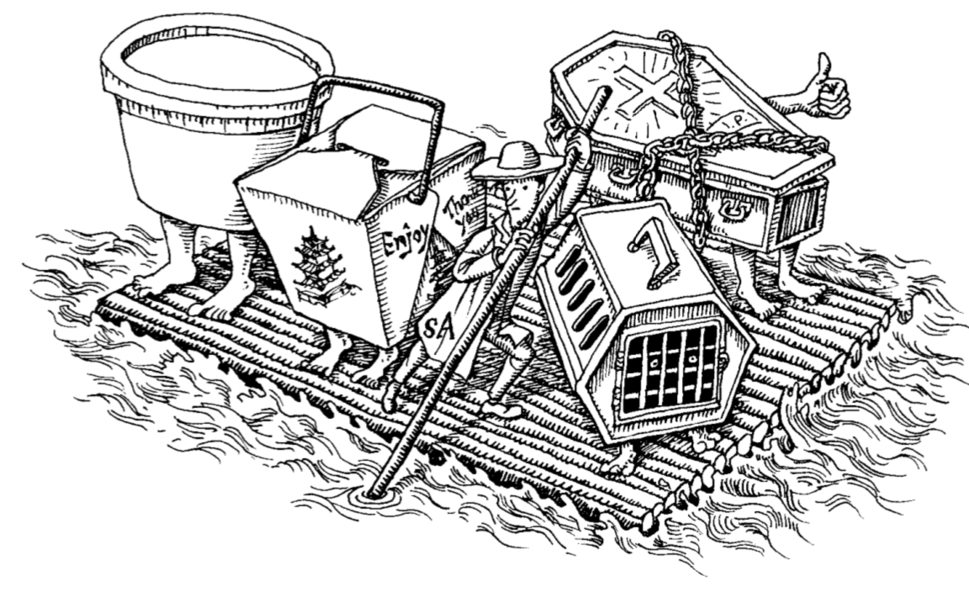
Containers

Slide 7
Containers
Containers are an isolated group of processes that are restricted to a private root filesystem and process namespace
Containers are built on a collection of existing Linux systems which allow it to run multiple different OS distributions as long as they share the same kernel
Containers run all their processes in userspace on top of a host OS with that host (and container engine) running and mediating all the processes
This method incurs near-zero overhead as this is all Linux processes running within a Linux OS, so little to no translation is necessary

Slide 8
Container Systems
Namespaces: allows for isolation of processes from the perspective of several operating system facilities. There are seven major namespaces (mount, UTS, IPC, PID, Network, User, and cgroups)
Control Groups: limits the use of system resources and prioritizes certain processes over others, prevents processes from consuming all CPU or memory resources
Capabilities: allows or disallows certain processes from running sensitive kernel system calls
Secure Computing Mode: restricts access to system calls and represents a more fine-grained version of capabilities
Notes:
mount: isolate filesystem mount points
UTS: isolate hostname and domainname
IPC: isolate interprocess communication (IPC) resources
PID: isolate PID number space
Network: isolate network interfaces
User: isolate UID/GID number spaces
Cgroup: isolate cgroup root directory

Slide 9
Container Images
Container images are templates for a container and rely on union filesystem mounts for performance and portability
Union filesystem mounts, unlike regular filesystem mounts, overlay multiple fileystems to create a single consistent hierarchy
Using this you can combine the file system necessary for the guest OS, that necessary for running commodity software, and that needed to run your specific piece of software together in a consistent and predictable manner
All these union filesystem mounts are combined into a base image which is read only, and then a read/write layer is added to the top for each individual container (since multiple containers can use the same base image)

Slide 10
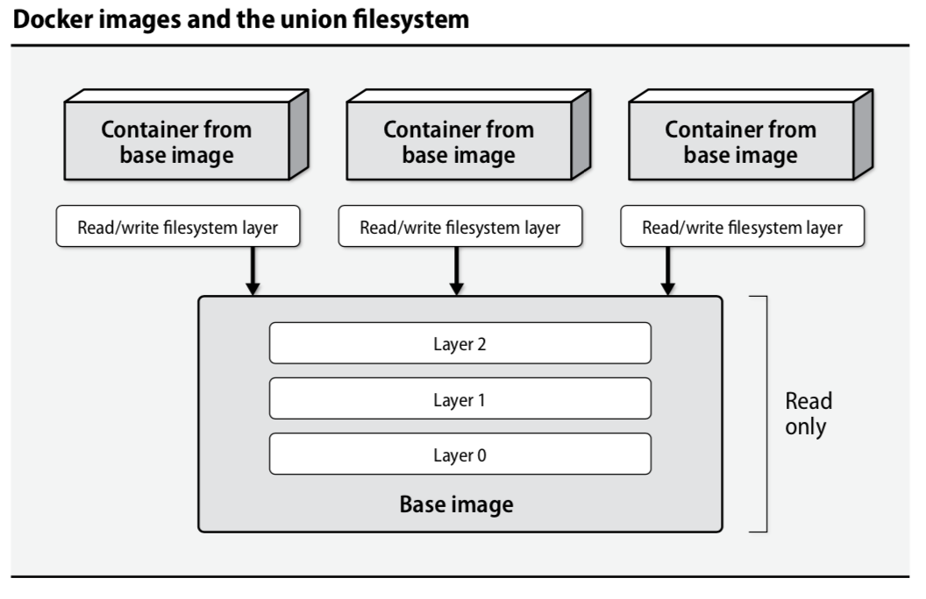

Slide 11
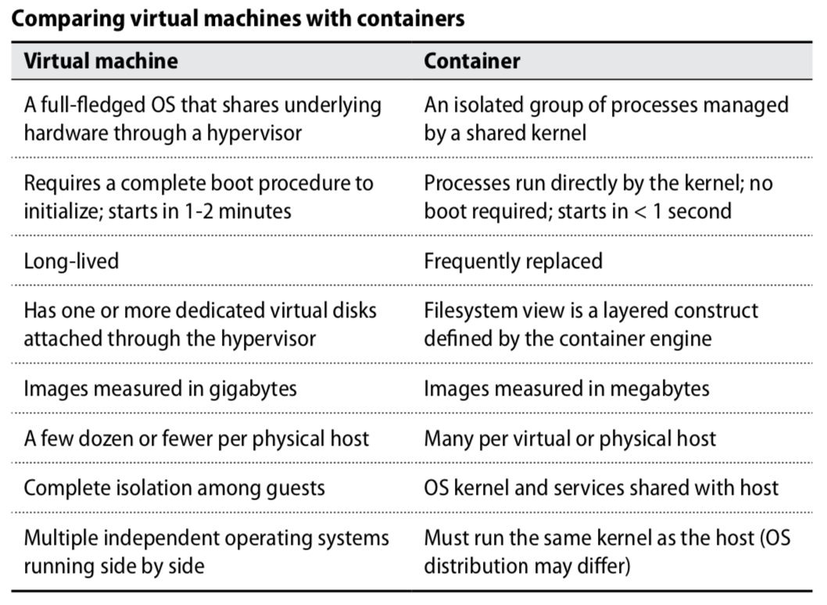
Virtual Machines vs. Containers

Slide 12
Questions?

Slide 13
Additional Resources
Linux Namespaces

